Slide 1
Introduction to Graphics

Slide 2
Introduction
There are two modes of output device:
Text Mode
Graphics Mode

Slide 3
Graphics Characteristics
Pixels
Resolutions
Colors
Video Adapters

Slide 4
Initializing Graphics Mode
We use initgraph() function
Syntax:
Intigraph(&graphics_driver,&graphics_mode,Path_to_driver);

Slide 5
Closing Graphics Mode
Function closegraph() is used.
Syntax:
closegraph();

Slide 6
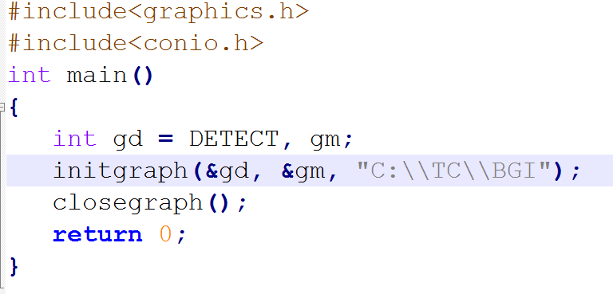
Sample Program

Slide 7
Error Handling
graphresult() function is used to check if certain graphics operation succeeded or not.
It return 0 for no error.

Slide 8
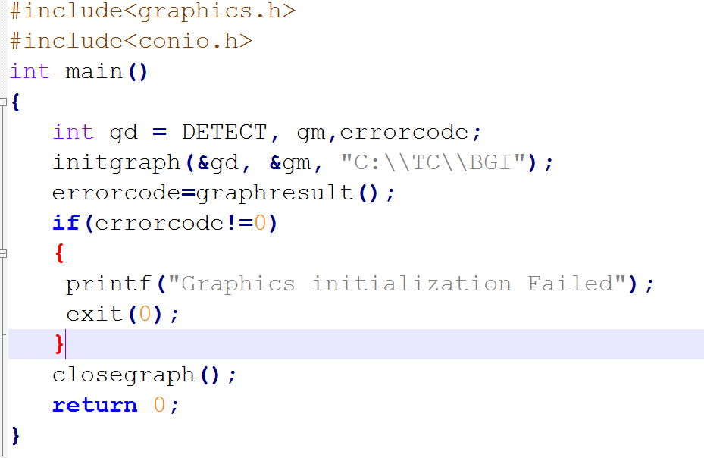

Slide 9
Some Functions in Graphics
putpixel() and getpixel()
setcolor() and setbcolor()
line()
circle()
ellipse
rectangle()
settextstyle() and outtext()
getmaxx() and getmaxy()

Slide 10
putpixel() and getpixel()
Syntax:
int getpixel(int x, int y);
void putpixel(int x, int y, int color);
getpixel returns the color of pixel present at point(x, y).
putpixel plots a pixel at a point(x, y) of specified color.

Slide 11
setbcolor()
Syntax :-
void setbkcolor(int color);
setbkcolor function changes current background color e.g. setbkcolor(YELLLOW) changes the current background color to YELLOW.
Remember that default drawing color is WHITE and background color is BLACK.

Slide 12
setcolor()
Syntax :-
void setcolor(int color);
setcolor function changes current drawing color e.g. setcolor(YELLLOW) changes the current drawing color to YELLOW.

Slide 13
line()
line function is used to draw a line from a point(x1,y1) to point(x2,y2)
Syntax :-
void line(int x1, int y1, int x2, int y2);

Slide 14
circle()
Syntax :-
void circle(int x, int y, int radius);
Circle function is used to draw a circle with center (x,y) and third parameter specifies the radius of the circle.

Slide 15
ellipse()
Syntax :-
void ellipse(int x, int y, int stangle, int endangle, int xradius, int yradius);
Ellipse is used to draw an ellipse (x,y) are coordinates of center of the ellipse, stangle is the starting angle, end angle is the ending angle, and fifth and sixth parameters specifies the X and Y radius of the ellipse.

Slide 16
rectangle()
Syntax:-
void rectangle(int left, int top, int right, int bottom);
Coordinates of left top and right bottom corner are required to draw the rectangle.

Slide 17
settextstyle()
Syntax :-
void settextstyle( int font, int direction, int charsize);
font argument specifies the font of text, Direction can be HORIZ_DIR (Left to right) or VERT_DIR (Bottom to top).

Slide 18
outtext()
outtext function displays text at current position.
Syntax :-
void outtext(char *string);

Slide 19
getmaxx() and getmaxy()
getmaxx function returns the maximum X coordinate for current graphics mode and driver.
Declaration :- int getmaxx();
getmaxy function returns the maximum Y coordinate for current graphics mode and driver.
Declaration :- int getmaxy();

Slide 20
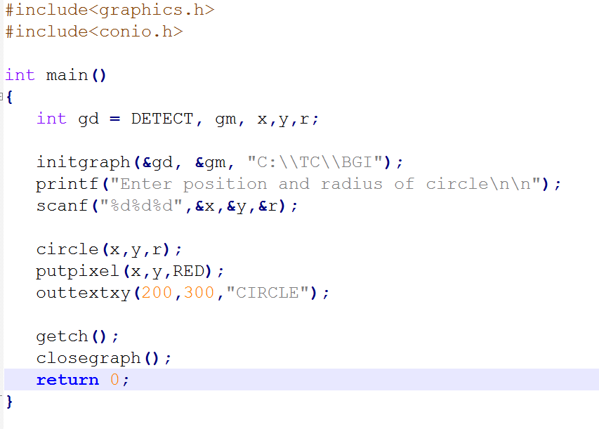

Slide 21
